Slide 1

King’s County House Sales Project
Mwangi Cynthia Sophie Wangui

Slide 2
Overview: Purpose of the project
This project is conducted in order to help realtors to understand where to invest and what features to invest in when building a home for sale.
This ultimately allows them to maximize on their profits but still have good rapport with potential buyers.

Slide 3
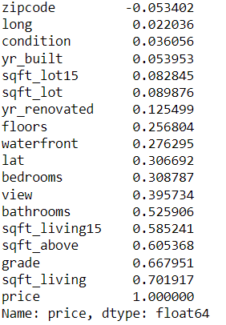
Correlation table
We then plot the graph of features that are most correlated to price; |5| and above

Slide 4
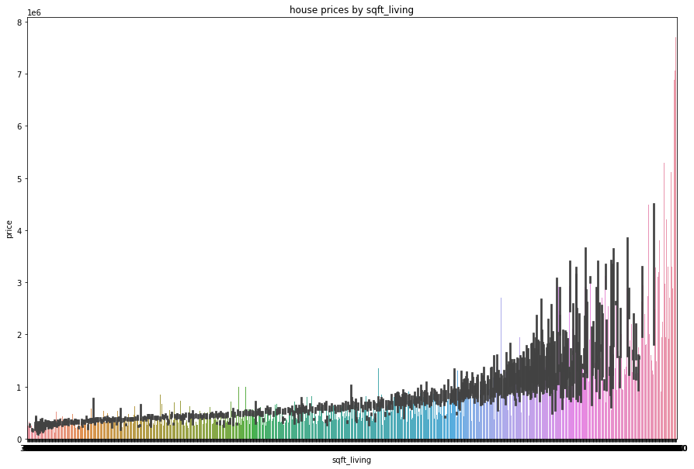
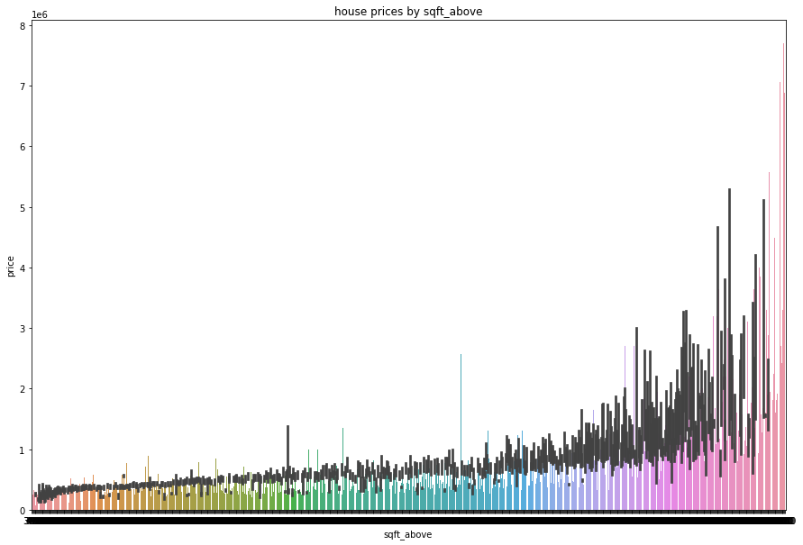
Correlation plots
Price vs sqft_living
PRICE VS SQFT_ABOVE

Slide 5
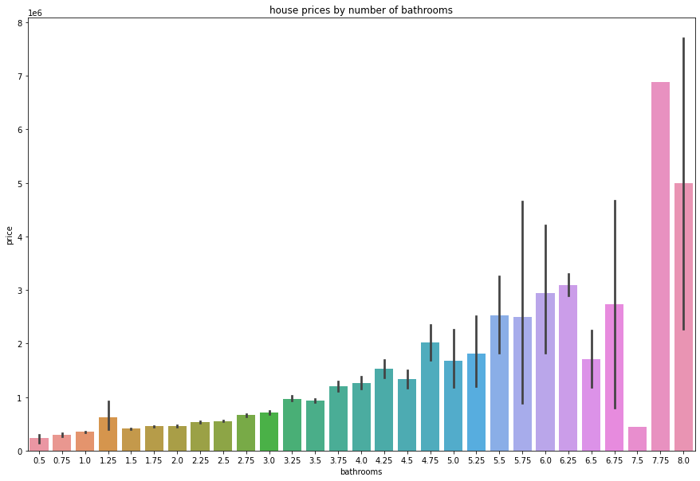
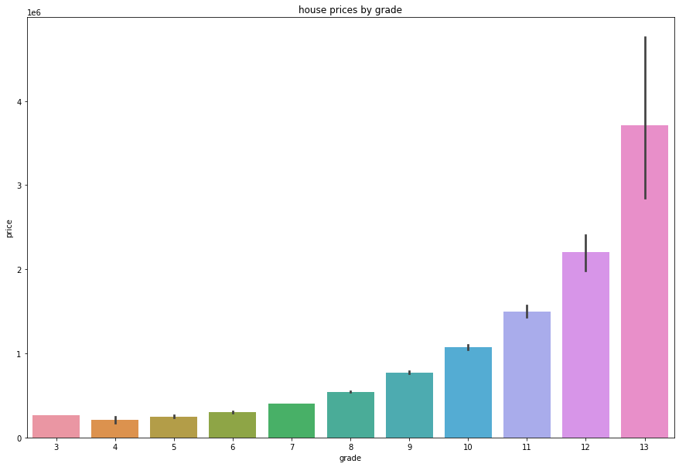
Correlation plots
Price vs NUMBER OF BATHROOMS
Price vs GRADE

Slide 6
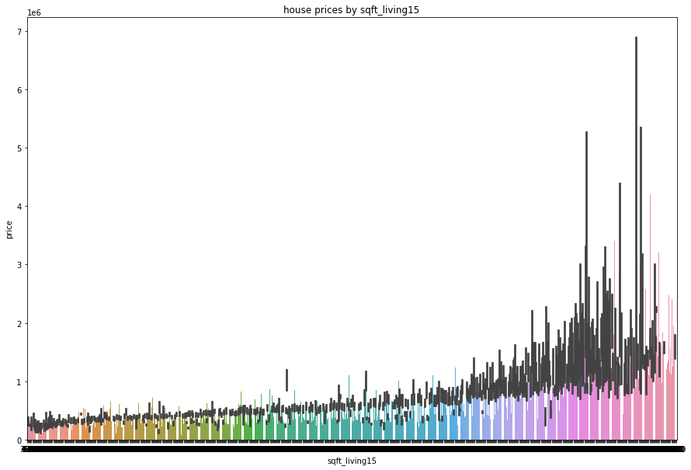
Correlation plots
Price vs NUMBER OF SQFT_LIVING15

Slide 7
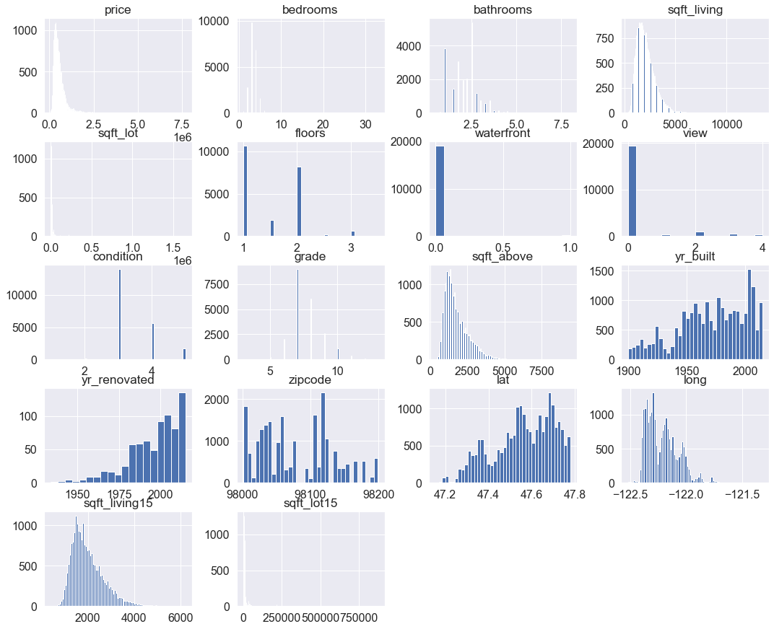
Checking for variable distribution
No Variable follows a standard normal curve, hence we transform them

Slide 8
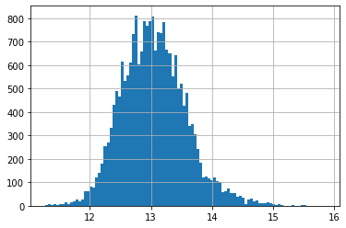
Transformation of the price variable

Slide 9
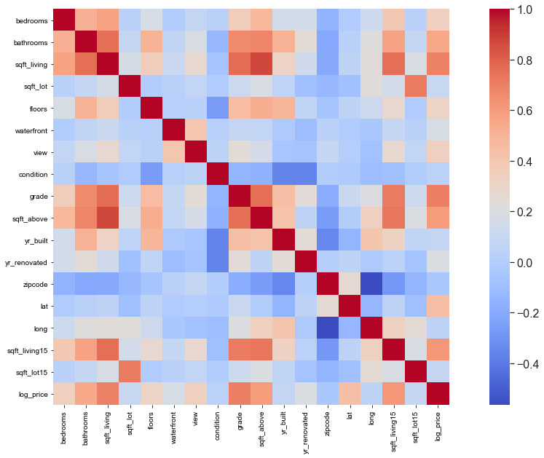
Independent variable correlation matrix

Slide 10
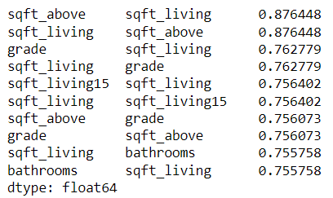
Choose most correlated variables
We choose;
Sqft_above, Sqft_living
Grade
Sqft_living15
Bathrooms

Slide 11
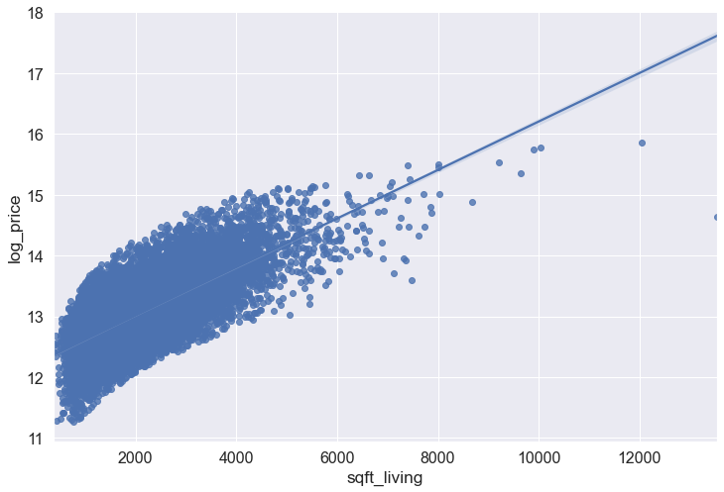
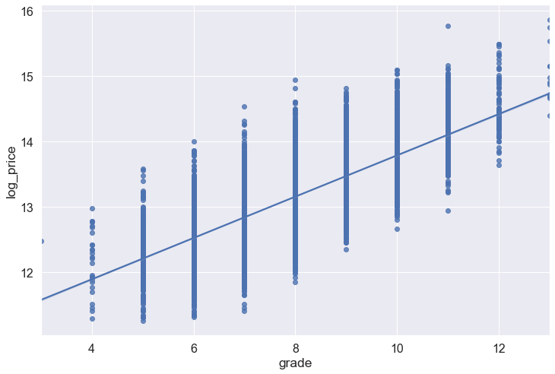
Checking for linearity in chosen variables
Sqft_living
grade

Slide 12
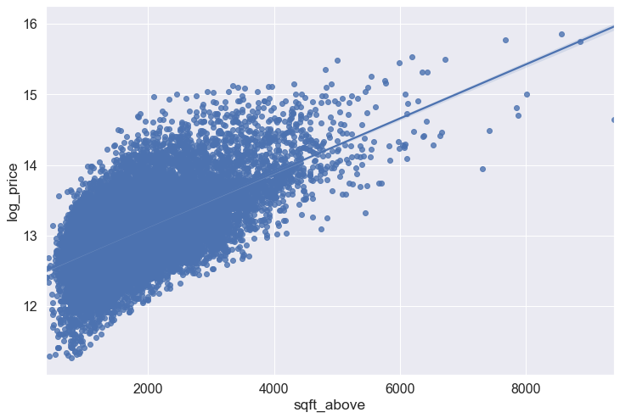
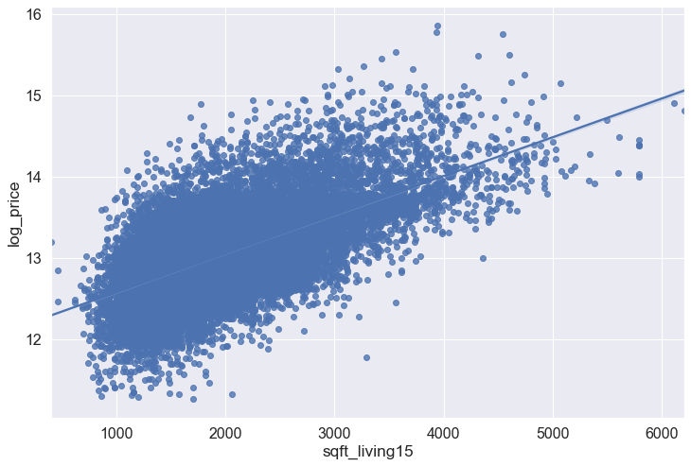
Checking for linearity in chosen variables
Sqft_above
Sqft_living15

Slide 13
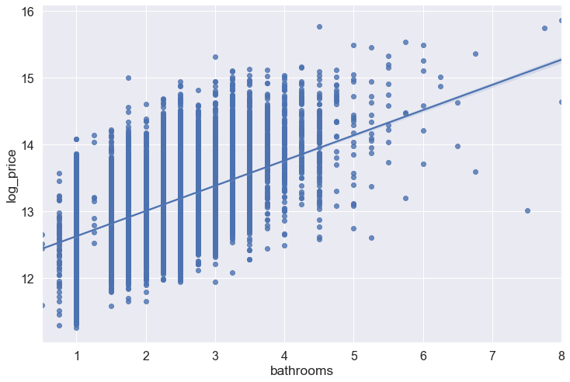
Checking for linearity in chosen variables
bathrooms
A linear relationship exists in all the variables chosen.
There is also presence of categorical data

Slide 14
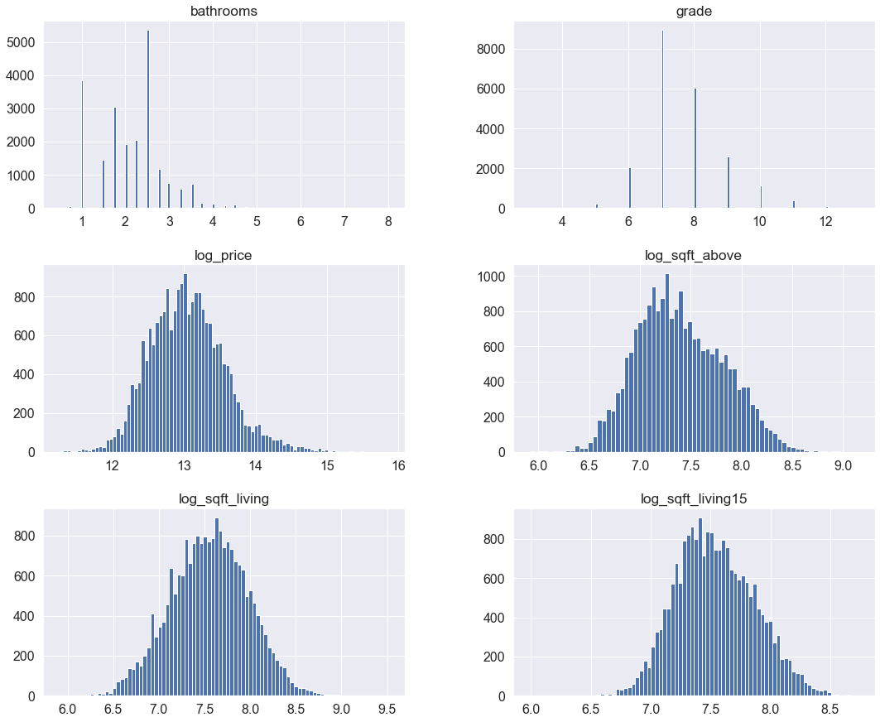
Checking for variable distribution after transformation

Slide 15
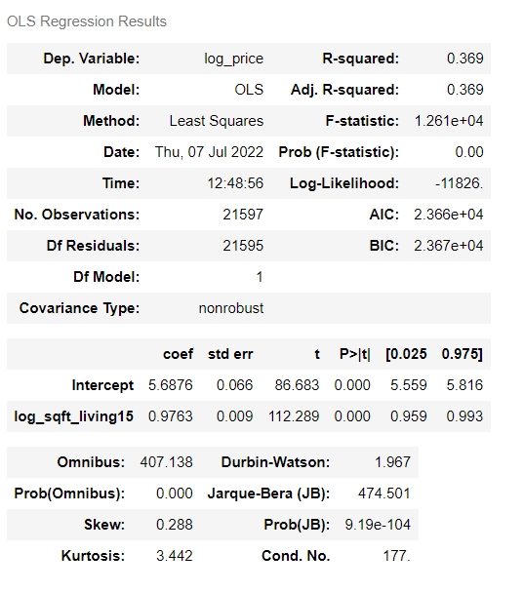
OLS MODEL COMPARISON
Fitting the model without transforming the data

Slide 16
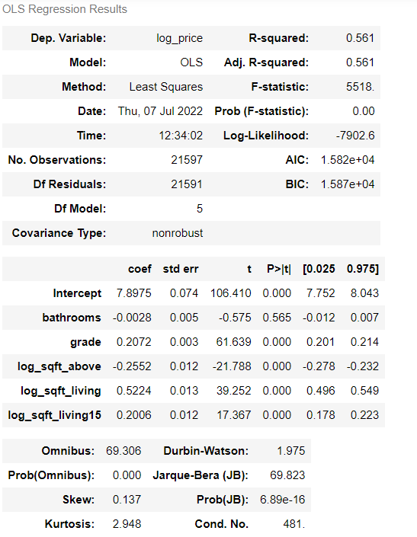
OLS MODEL COMPARISON
Fitting the model after transforming the data

